Slide 1
Unit 1: Introduction to ASP.NET MVC 3

Slide 2
Lesson: ASP.NET MVC 3
ASP.NET MVC Overview
What’s new in ASP.NET MVC 3
Razor View Engine
Multi View Engine Support
Model Validation Improvements
Dynamic ViewBag
New Action Results
HTML 5 Project Templates
Other
Demo
Q&A
Reference

Slide 3
ASP.NET MVC Overview
The ASP.NET MVC framework provides an alternative to the ASP.NET Web Forms pattern for creating MVC-based Web applications.
The ASP.NET MVC framework is a lightweight, highly testable presentation framework that (as with Web Forms-based applications) is integrated with existing ASP.NET features, such as master pages and membership-based authentication.

Slide 4
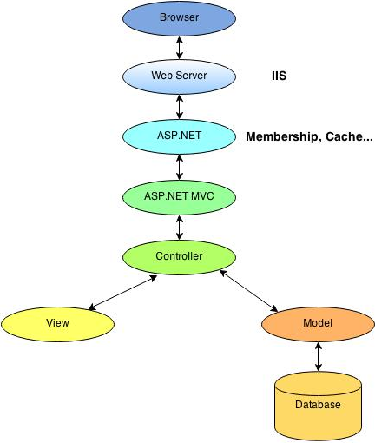
ASP.NET MVC Overview Working Model

Slide 5
What’s new in ASP.NET MVC 3
Razor View Engine
Multiple View Engine Support
Validation Improvements
Dynamic ViewBag
Global Filters
New ActionResults
Project Dialog Improvements
VBHTML Support
Task-based Helpers
Improved Dependency Injection
Porting MVC Script Libraries to jQuery
Granular ValidateInput
Add View Dialog Improvements
Project Dialog Extensibility Improvements
Improved Caching Support
JSON Binding Support

Slide 6
Razor View Engine
Razor is an ASP.NET programming syntax used to create dynamic web pages with the C# or Visual Basic .NET programming languages.
Instead of using the ASP.NET .ASPX markup syntax with <%= %> symbols to indicate code blocks, Razor syntax starts code blocks with a @ character and does not require explicit closing of the code-block.
Notes:
The Razor syntax is a template markup syntax, based on the C# programming language, that enables the programmer to use an HTML construction workflow^{[clarification needed]}. Instead of using the ASP.NET .ASPX markup syntax with <%= %> symbols to indicate code blocks, Razor syntax starts code blocks with a @ character and does not require explicit closing of the code-block.
@model syntax for specifying the type being passed to the view.
@* *@ comment syntax.
The ability to specify defaults (such as layoutpage) once for an entire site.
The Html.Raw method for displaying text without HTML-encoding it.
Support for sharing code among multiple views (_viewstart.cshtml or _viewstart.vbhtml files).

Slide 7
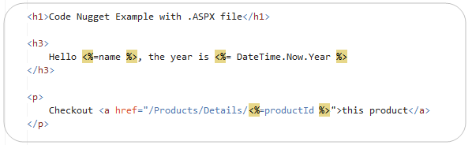
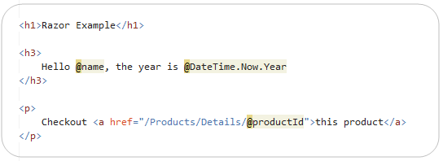
Razor View Engine - Syntax
Web Form
Razor

Slide 8
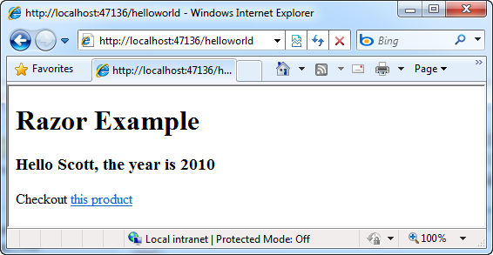
Results

Slide 9
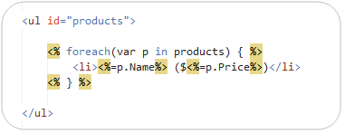
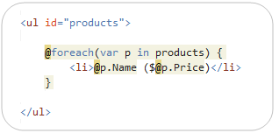
Razor View Engine - Loops and Nested HTML Sample
Web Form
Razor

Slide 10
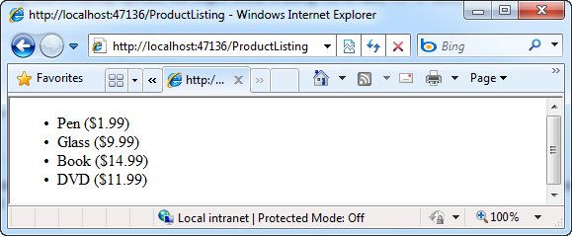
Razor View Engine - Loops and Nested HTML Sample

Slide 11
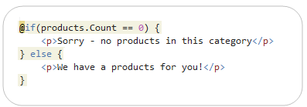
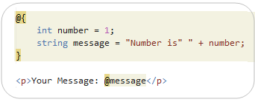
Razor View Engine - If-Blocks and Multi-line Statements
If Statements
Multi-line Statements
Notes:
Notice above how variables can span multiple server code blocks – the “message” variable defined within the multi-line @{ } block, for example, is also being used within the @message code block. This is conceptually the same as the <% %> and <%= %> syntax within .aspx markup files.
Multi-Token Statements
The @( ) syntax enables a code block to have multiple tokens. For example, we could re-write the above code to concatenate a string and the number together within a @( code ) block:

Slide 12
Razor View Engine - Others
Integrating Content and Code
Layout/MasterPage Scenarios
Encapsulation and Re-Use with HTML Helpers
Visual Studio Support
Notes:
Refer to this http://weblogs.asp.net/scottgu/archive/2010/07/02/introducing-razor.aspx

Slide 13
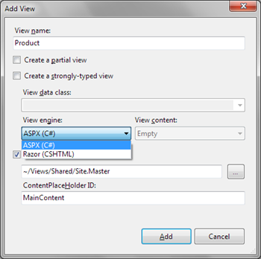
Multi View Engine Support
There will be two out-of-box view engines:
ASPX-based views
Razor-based views
an open-source view engine such as Spark, NHaml, or NDjango.
Notes:
If you select another view engine then file and master page names are changed appropriately.

Slide 14
Model Validation Improvements
DataAnnotations Metadata Attributes
ValidationAttribute Class
Validation Interfaces
Notes:
ASP.NET MVC 3 supports DataAnnotations metadata attributes such as DisplayAttribute.

Slide 15
Dynamic ViewBag
Accessible via properties
Properties map to ViewData entries
Late-bound
<head>
<title>@ViewBag.Title<title>
</head>

Slide 16
New Action Results
HttpNotFoundResult
RedirectResult
HttpStatusCodeResult

Slide 17
HTML 5 Project Templates
The New Project dialog includes a checkbox enable HTML 5 versions of project templates.
Notes:
The New Project dialog includes a checkbox enable HTML 5 versions of project templates. These templates leverage Modernizr 1.7 to provide compatibility support for HTML 5 and CSS 3 in down-level browsers.

Slide 18
Others
NuGet Integration
Partial-Page Output Caching
Granular Control over Request Validation
Extensible "New Project" Dialog Box
Template Scaffolding Improvements
New Overloads for "Html.LabelFor" and "Html.LabelForModel“
Sessionless Controller Support
New "AdditionalMetadataAttribute" Class
AccountController improvements
New Intranet Project Template
Notes:
Refer to this link for more details about other features
http://www.asp.net/mvc/mvc3#BM_Other_New_Features

Slide 19

Demo
Notes:
Refer to this link to demo
http://www.asp.net/mvc/tutorials/getting-started-with-aspnet-mvc3/cs/intro-to-aspnet-mvc-3

Slide 20

Q&A

Slide 21
http://weblogs.asp.net/scottgu/archive/2010/07/02/introducing-razor.aspx http://www.asp.net/mvc/mvc3
Reference

